Slide 1
Car Following Senior Project Sprint 2
Josh Baird, Evan Haskell, Justin Kur, Cody Trombley, Charlie Wingate

Slide 2
Project Plan by Sprint
Sprint 1
Acquire vehicles and confirm working status and begin becoming familiar with existing codebase.
Sprint 2
Allow controller machine to record image data it has sent; Begin mirroring mode implementation, Add ability to control camera movement.
Sprint 3
Finish Mirroring mode; Collect and label training data; Train and test mirrored inputs machine learning model; Develop camera control module.

Slide 3
Project Plan by Sprint (continued)
Sprint 4
Enable vehicles to share data and incorporate into model; Adjust model hyperparameters
Sprint 5
Explore object avoidance protocols; Implement switching leader and follower during execution
Sprint 6
Train and test machine learning model with object detection
Sprint 7 & 8
Testing, Bug fixes, and Code Optimizations

Slide 4
Sprint Achievements
Python refactors
Camera movement
Image saving
More detailed log export
Basic log replay

Slide 5
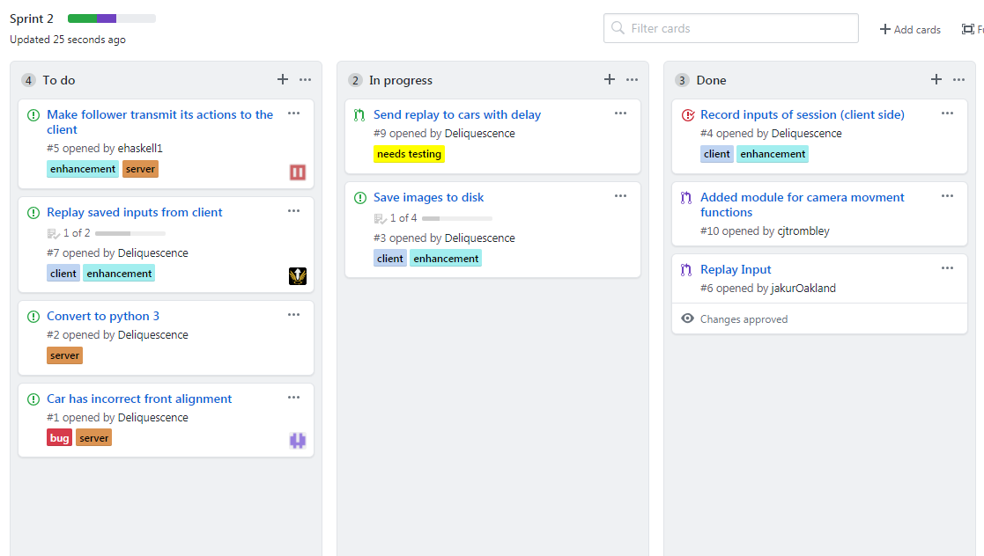

Slide 6
Next Sprint Objectives
Finish mirroring mode
We have working time delay code, but really a “distance delay” will give us better training data
Collect driving training data
Test drives must be performed so that examples of proper following behavior can be saved
Begin labeling data for supervised learning
We will both provide labels for classification and bounding boxes so the network can learn distance
Port existing PiCar library code to Python 3

Slide 7
Challenges
Car python version is 2.7, but we would prefer python 3 for Pytorch
To work with cars requires changing of network connections
Mirror mode is not as simple as previously expected
Limited number of vehicles makes testing more difficult

Slide 8
Risks and Mitigations
Machine Learning
We plan to use machine learning to train an AI on how to properly respond to the leader car’s movements.
If the computer vision turns out to not function adequately, we can still improve the existing tag based following mechanism.
Object Detection for Obstacle Avoidance
We may train the model to detect objects which could be considered obstacles.
This model may or may not prove to be viable.

Slide 9
